Slide 1
Group 9
Under Supervision of: Dr. Nabajyoti Mazumdar
Group Members :
Anupam Raj (IIT2020034)
Rohan Tirkey (IIT2020088)
Arjun Yadav (IIT2020120)
Satyam Gupta (IIT2020143)

Slide 2
Homogenous Multiple Depot Multiple Travelling Salesman

Slide 3
INTRODUCTION
In the Standard Travelling Salesman Problem, we have a single salesman and multiple targets and we have to find an optimal path that will visit all the targets exactly once and after that the salesman will return to its original location (depot). It is a single depot problem. In the problem assigned to us is the extended version of Standard Travelling Salesman Problem, here we have multiple depots and different target locations

Slide 4
Definition
of Certain terms
Homogenous vehicles:
All the vehicles will have similar capacity, power or ability.
Multiple Depot:
Depots meaning the starting point of the vehicles.So, Multiple depots means multiple travellers/UAV/vehicles may have different starting point. So, assigning a keeping the depot according to our targets may optimize our cost.
Multiple traveller:
It means there are multiple travellers/vehicles that will deliver the packets or will carry the attacks in case of UAV.

Slide 5
Objectives:
Minimize Distance: Minimize the total distance traveled to complete the tour.
Workload Management: To balance the workload among the unmanned aerial vehicles, to ensure an equitable distribution of tasks.
Scalability: To provide a scalable solution, such that we can handle a large number of targets , UAVs and depots.
Increase the success of the mission, by ensuring that all the target locations are visited efficiently.
Make a pictorial representation of the solution for easy visualization and understanding.

Slide 6
Literature Review
HMDMTSP Survey In this paper, HMDMTSP Survey released by Laporte and his team in 2017, they discussed about various questions that can arises related to Homogenous Multiple Depot, Multiple travelling salesman problem
Vehicle Routing Problem The paper ”Vehicle routing problem” published by Toth and Vigo in 2014, focuses on car routing. It is actually Car routing detail introduction problem.
Multi-Depot Vehicle Routing The paper ”Multi-Depot Vehicle Routing” authored by Duhamel and his team in 2020. The main aim of the Duhamel and his team members to research over controlling the multi warehouse traffic field variants of the routing problem

Slide 7
Literature Review
An Algorithm for Homogenous VRP This paper is published by Ma and Liu in 2018. They have started the research with aim to solve Homogeneous Vehicle Routing Problem, a variant of HMDMTSP and develop a optimal solution.
Metaheuristic for HMDMTSP This paper is published by Braysy and Dullaert in 2005.They have studied metaheuristic methods and solved HMDMTSP using that.After that , they evaluated its effectiveness. Their methodology is do qualitative analysis of various meta-heuristic methods such as simulated annealing, tabu search and genetic algorithms while solving the HMDMTSP

Slide 8

METHODOLOGY
Random Solution
We have generated a 100000 random solution for this problem and taken the best ones. By using nextInt in java and keeping filter for unique cities, we tried to get best solution in computationally feasible time.
The number of depots and salesman per depot will be our parameters. The cost metric will be total distance in kilometers. At the end, we will print the best solution that has the minimum cost among 100,000 random solutions.

Slide 9
Method-2: Hill Climbing
We are using hill climbing method to move forward from one random solution to next better solution only. So, pruning other worse branches.
The move operations used are:
1. Swap Nodes In Route
2.swap Hub With Node In Route
3.swap Nodes Between Routes
4.insert Node In Route
5.insert Node Between Routes

Slide 10
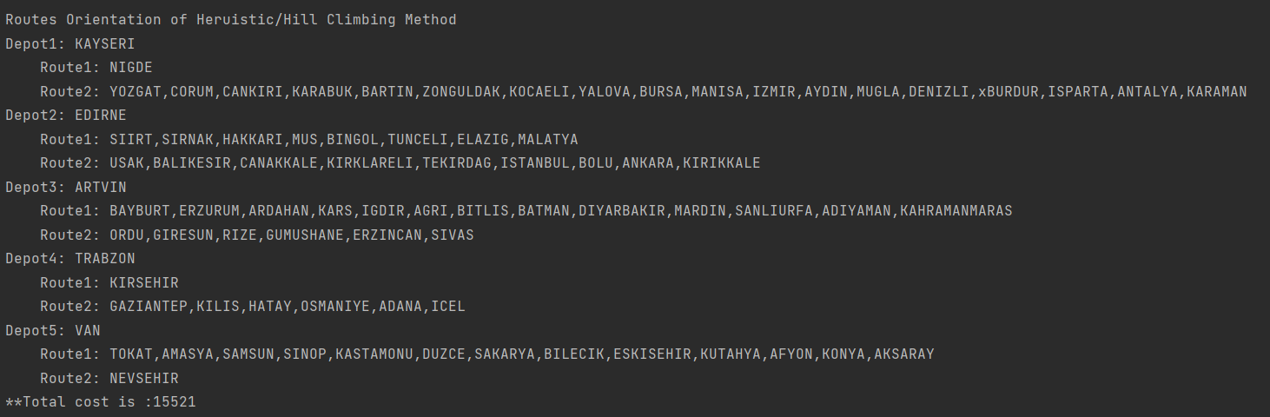
Hill Climbing Contd:
Output:

Slide 11
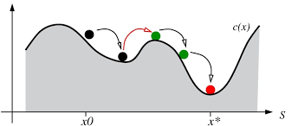
Method-3: Simulated Annealing [Optimization over Hill climbing]
We are using simulated annealing to further optimizing our Hill climbing solution which could not accept the worse solution while jumping, so it might stuck in local minima. So, using temperature and cooling rate parameters , we will accept the slightly worse solution with certain probability.

Slide 12
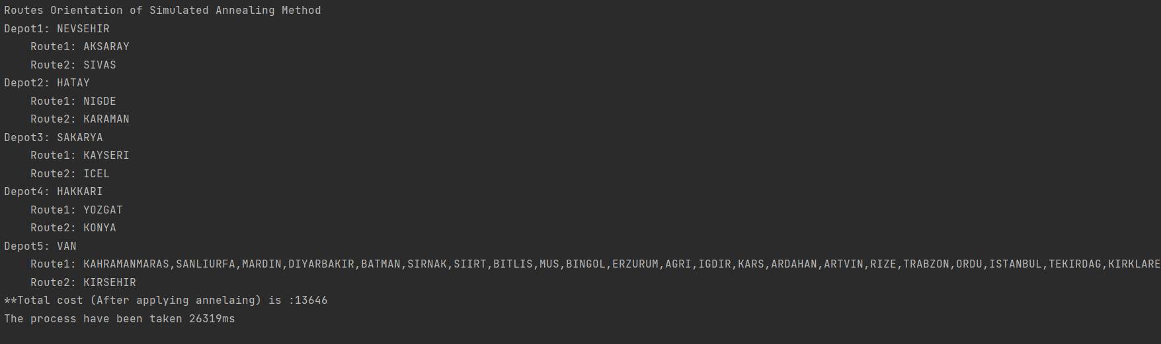
Method-3: Simulated Annealing [Optimization over Hill climbing]
Output:

Slide 13
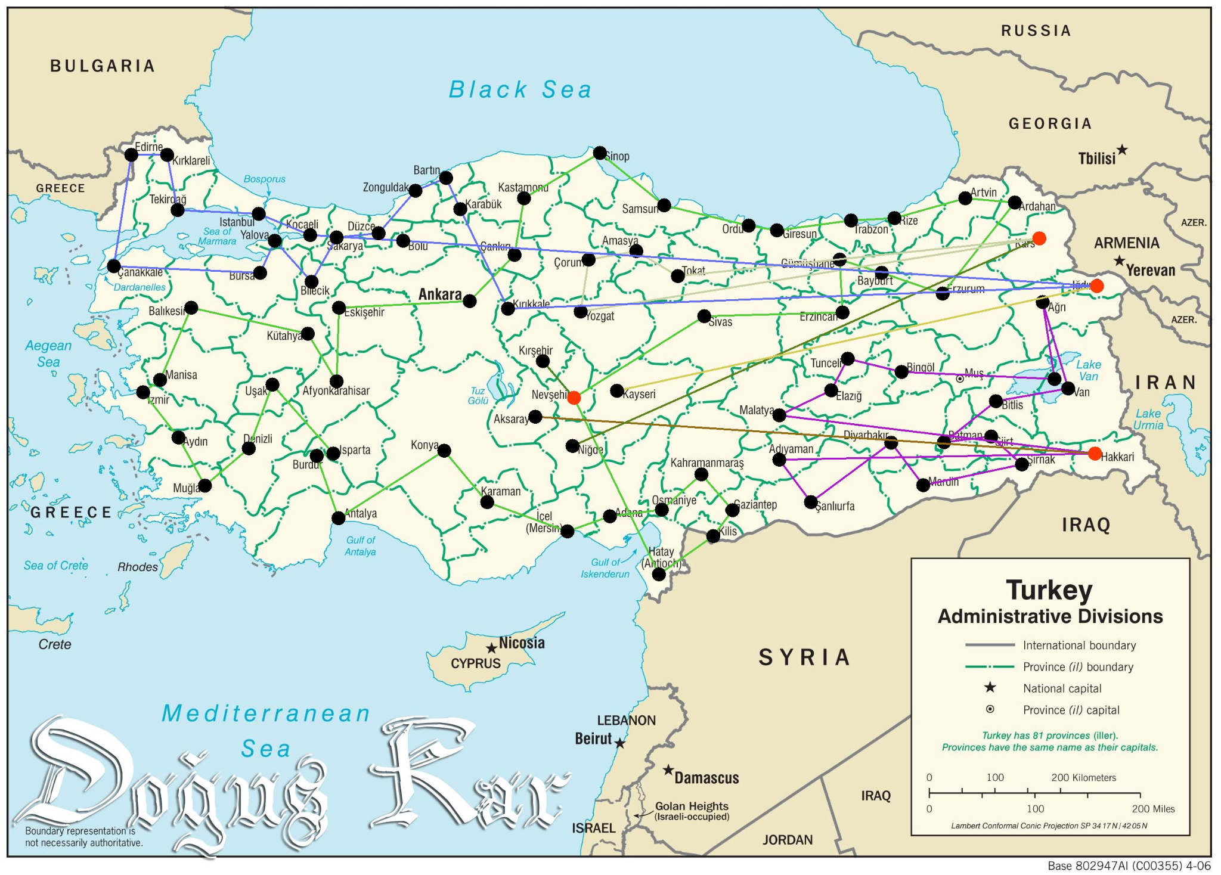
Image Depiction of the Solution:

Slide 14
Dataset
The dataset used are given in zip file as distance matrix . It is 80*80 matrix which contains mutual distance between 80 cities of Turkey.
We are also giving name of Turkey cities in a array format to identify the name and in result cities name are also fetched from that array.
For creating the image solution, a empty map of turkey are given in resource folder and respective cities coordinate are in createImageSol file.

Slide 15
Results
On using Random Bruteforce solution , we are getting on-average 50,000 km as total distance covered .
After applying, we are getting on-average 18,000-19,000 km as total distance covered. That is 360% improvement over random ones.
After optimizing again by simulated annealing, we got 13,000 km as total distance covered. That is another 138% improvement over Hill climbing method.
Ek bar

Slide 16
Conclusions
In this project, we tested different approaches the solve the NP-Hard problem of HMDMTSP using various heuristics mentioned from step 2 onwards, after generating the initial solution randomly.
At the end, the simulated annealing approach was able to optimize the problem by a great extent, generating solutions which are better than the just using the heuristic approach mentioned in the step 2.

Slide 17
References
[1] P.Toth and D.Vigo, The vehicle routing problem, Society for Industrial and Applied Mathematics, Philadelphia,PA, USA, 2001.
[2] S. Rathinam, R. Sengupta, S. Darbha, A resource allocation algorithm for multiple vehicle systems with non-holonomic constraints, IEEE Transactions on Automation Science and Engineering 4(1) (2007) 98- 104.
[3] Waqar Malik, Si vakumar Rathinam, Swaroop Darbha: An approximation algorithm for a symmetric generalized Multiple Depot, Multiple Travelling Salesman Problem. Operations Research Letters, 35(6): 747-753 (2007)
[4] P. Oberlin, S. Rathinam, and S. Darbha, A Transformation for the Multiple Depot, Multiple Tra veling Salesman Problem, American Control Conference, 2009
[5]https://genius.com/Atodd-the-traveling-salesman-with-simulated-annealing-r-and-shiny-annotated

